Slide 1
Strategic Contractor Prequalification: Enhancing School Project Success in Challenging Times

Slide 2
Presenters
Lettie Boggs COLBI CEO
Julie Arthur Executive Director of Facilities Planning & Development
Palm Springs Unified SD
Jamin Boggs Division Director – QualityBidders

Slide 3
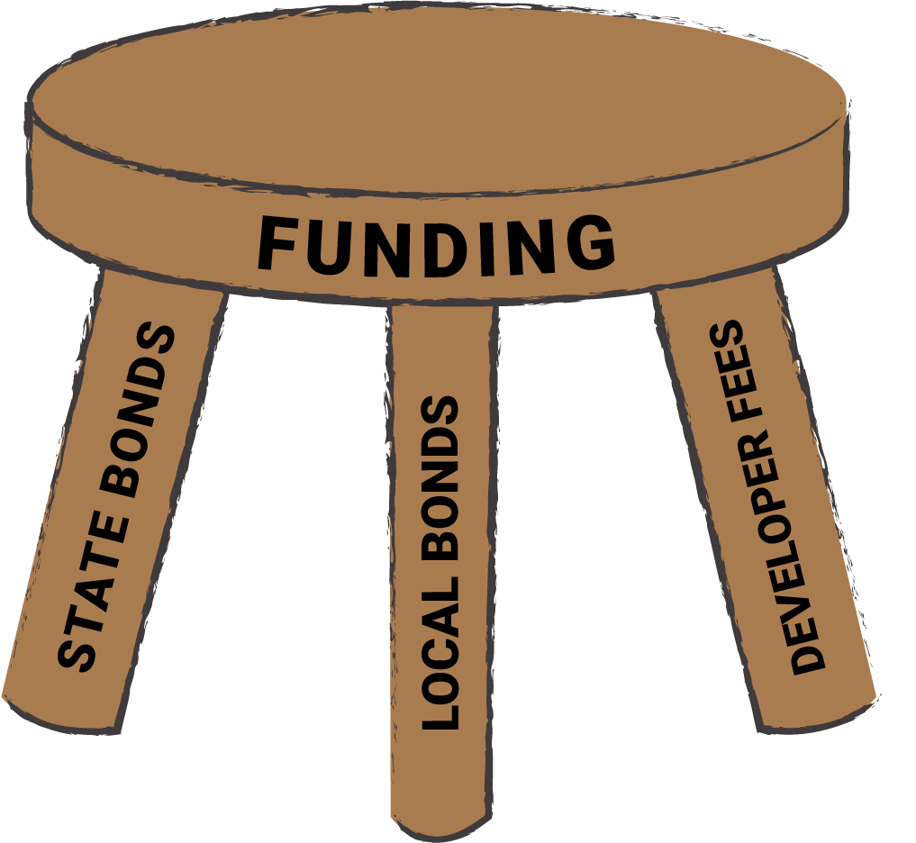
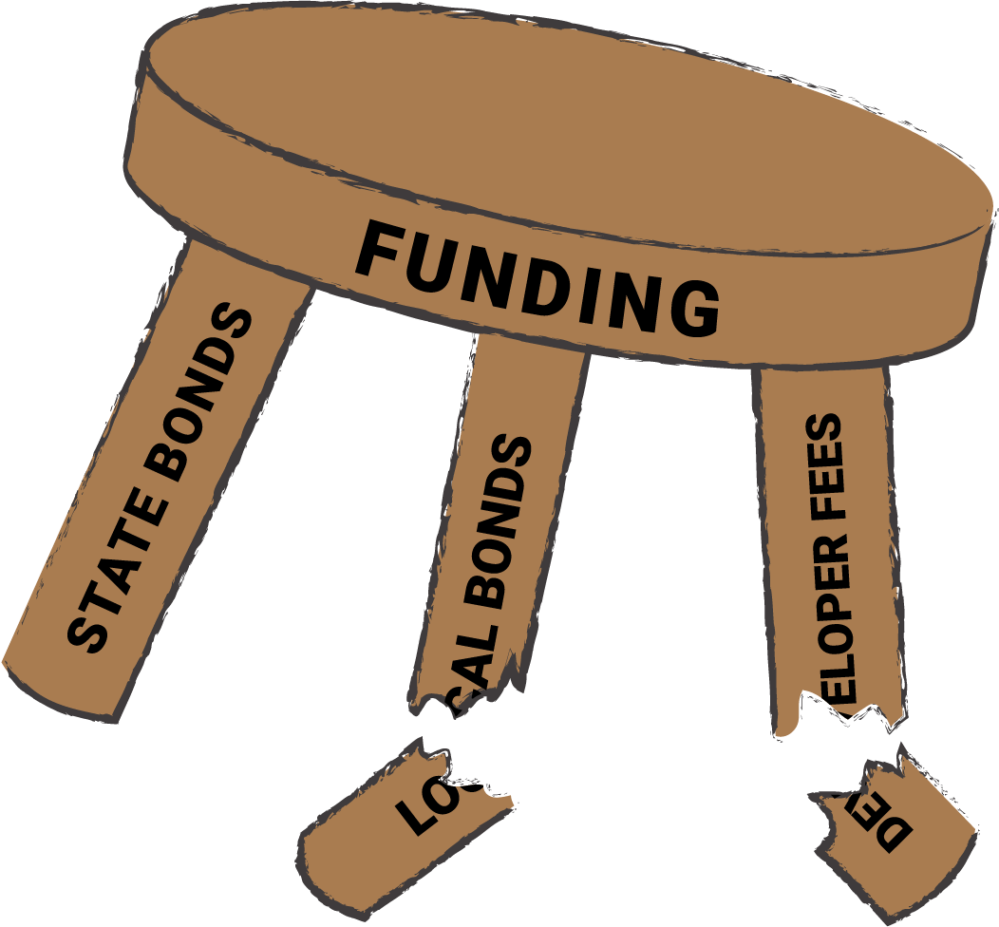
Overview of Economic Challenges
Notes:
California public school facilities face economic challenges, including budget constraints, rising construction costs, deferred maintenance, and the impact of economic downturns. Population fluctuations and compliance with regulatory requirements further complicate funding. Additionally, school facility funding competes with other public infrastructure needs. Original Content: California public school facilities face several economic challenges, particularly during periods of economic downturn. These include: Budget Constraints and Funding Shortfalls Public school construction and maintenance projects are heavily reliant on state bonds, local bond measures, and state funding programs like the State School Facilities Program. Economic downturns often lead to reduced tax revenues, impacting state and local funding for new construction and critical renovations. Voter reluctance to approve new bond measures further exacerbates funding gaps. Rising Construction Costs Inflation in labor, materials, and supply chains has significantly increased construction costs. Factors like skilled labor shortages and the rising cost of raw materials (e.g., steel, concrete, and lumber) strain project budgets. Deferred Maintenance Backlog Many schools have delayed maintenance due to lack of funds, resulting in deteriorating facilities and safety concerns. Addressing these backlogs requires significant investment that often exceeds available resources. Impact of Economic Downturns Economic downturns reduce state income tax and property tax revenues, the primary sources for school funding. This causes delays or cancellations of planned projects. Local school districts face pressure to prioritize operational budgets (teacher salaries, technology, student programs) over capital investments. Population Fluctuations Declining student enrollment in certain districts (due to demographic changes or shifting population patterns) creates uncertainty around facility needs, reducing justification for large capital expenditures in some areas. Conversely, rapidly growing regions may struggle to secure funds quickly enough to build necessary new facilities. Compliance with Regulatory Requirements Schools must comply with strict regulations, such as California Environmental Quality Act (CEQA) requirements, seismic retrofitting laws, and energy efficiency mandates. While beneficial in the long term, these requirements often increase short-term project costs. Competition for Limited Resources School facility funding competes with other pressing public infrastructure needs, such as housing, transportation, and healthcare projects, which further constrains available resources.

Slide 4
How Did We Get Here

Slide 5
Contractor Prequalification
Purpose of Contractor Prequalification
Types of Prequalification
Benefits of Prequalification
Ensures contractors meet criteria before bidding
Assesses financial stability, technical capability, past performance, and safety records
Administrative Prequalification
Basic financial and legal requirements
Includes bonding capacity, insurance, and licensing
Performance-Based Prequalification
Project-Specific Prequalification
Reduces risks and ensures higher construction quality
Streamlines project execution for public agencies
Notes:
Contractor prequalification is a process used by public agencies to evaluate contractors before they bid on projects. It includes administrative, performance-based, and project-specific assessments. This ensures only qualified contractors compete, reducing risks and improving construction quality. Original Content: Definition of Contractor Prequalification Contractor prequalification is a formal process used by public agencies, such as school districts or state departments, to assess and determine a contractor's ability to perform work on a specific project or category of projects before they are allowed to bid. This evaluation ensures that only contractors who meet established criteria related to financial stability, technical capability, past performance, safety records, and other qualifications are permitted to compete for public works projects. Prequalification can take the form of: Administrative Prequalification: Basic financial and legal requirements (e.g., bonding capacity, insurance, and licensing). Performance-Based Prequalification: Evaluates a contractor's past performance, quality of work, claims history, and ability to meet project timelines. Project-Specific Prequalification: Assesses qualifications tailored to the unique requirements of a specific project (e.g., seismic retrofitting, specialized systems). By filtering out unqualified or underperforming contractors, prequalification reduces risks, ensures higher construction quality, and streamlines project execution for public agencies.

Slide 6
Adhering to Legal and Procedural Frameworks
Ensures Legal Compliance
California regulations ensure transparency and fairness in bidding
Public Contract Code (PCC) §20111.5 permits prequalification procedures for school districts
Public Contract Code (PCC) §20111.6 prescribes prequalification for contractors on projects over $1 million State funded and ADA 2500
DIR Guidelines oversee compliance with public works laws, including contractor qualifications
Avoids Legal Challenges
Strict adherence prevents legal challenges and bid protests
Non-compliance may invalidate the bidding process
Failure to comply can lead to costly project delays and disruptions
Notes:
Adhering to California's contractor prequalification frameworks ensures legal compliance, transparency, and fairness. Key regulations include PCC §20111.5, AB 1565, and DIR Guidelines. Compliance avoids legal challenges, bid protests, and costly delays. Original Content: Importance of Adhering to California's Legal and Procedural Frameworks Governing Contractor Prequalification Adhering to California's legal and procedural frameworks for contractor prequalification is critical to ensuring public school facilities projects are successful, transparent, and compliant with state law. These frameworks establish the guidelines that public agencies must follow when vetting contractors, balancing the need for fair competition with the responsibility to select qualified, capable contractors. Below are key reasons why compliance is essential: 1. Ensures Legal Compliance California has specific regulations governing contractor prequalification, primarily to ensure transparency and fairness in the bidding process. Key legal frameworks include: Public Contract Code (PCC) §20111.5: Allows school districts to establish prequalification procedures to vet contractors bidding on projects funded by public funds. AB 1565: Requires contractors bidding on California K-12 school projects exceeding $1 million to be prequalified if funded through specific bonds (e.g., Leroy F. Greene School Facilities Act). DIR Guidelines: The Department of Industrial Relations (DIR) oversees compliance with public works laws, including contractor qualifications, prevailing wage requirements, and labor compliance. Strict adherence to these frameworks avoids legal challenges, bid protests, and costly project delays. Failure to comply may invalidate the bidding process, leading to significant disruptions.

Slide 7
Promoting Fair and Transparent Contractor Selection
Objective and Justifiable Prequalification Processes
Evaluation Based on Transparent Criteria
Equal Opportunity for All Contractors
Must align with principles of open competition for public works
Ensure non-discriminatory practices
Financial stability
Past project performance
Safety records
Claims history
Prevents favoritism and bias
Ensures inclusion of qualified businesses
Enhances Trust Among Stakeholders
Notes:
Prequalification processes should be fair, objective, and non-discriminatory. Contractors are evaluated based on transparent criteria like financial stability and past performance. This ensures equal opportunity, prevents bias, and builds trust among stakeholders and the public. Original Content: 2. Promotes Fair and Transparent Contractor Selection Prequalification processes must be objective, justifiable, and non-discriminatory to align with the principles of open competition required for public works. Adhering to legal requirements ensures: Contractors are evaluated based on clearly defined, transparent criteria, such as financial stability, past project performance, safety records, and claims history. All contractors are provided an equal opportunity to compete, preventing favoritism, bias, or exclusion of qualified businesses. A transparent prequalification process enhances trust among contractors, stakeholders, and the public.

Slide 8
Reducing Project Risks and Enhancing Accountability
Mitigating Risks in Public Construction Projects
Screening contractors for financial stability to prevent project abandonment
Evaluating past performance to exclude contractors with poor work history
Ensuring adherence to safety and labor laws for worker welfare
California's Prequalification Laws
Holding contractors accountable for performance and compliance
Creating a culture of higher quality and reliability
Notes:
Prequalification laws in California help reduce project risks by screening contractors for financial stability, evaluating past performance, and ensuring legal compliance. This accountability fosters higher quality and reliability in public construction projects. Original Content: 3. Reduces Project Risks and Enhances Accountability The legal frameworks governing prequalification are designed to mitigate risks associated with public construction projects, such as: Contractor Defaults: Screening contractors for financial stability ensures they have the capacity to complete the project without abandoning work. Substandard Performance: By evaluating a contractor’s past performance and technical capabilities, districts can identify and exclude contractors with a history of poor work or project delays. Legal and Safety Compliance: Contractors must demonstrate adherence to safety and labor laws, ensuring worker welfare and reducing liability for the district. California’s prequalification laws hold contractors accountable for their performance and compliance, creating a culture of higher quality and reliability.

Slide 9
Obligation vs Opportunity
Legal Mandates:
California Public Contract Code (§20101 §20111.5 & §20111.6) require prequalification for public school construction projects exceeding $1 million funded by state bonds.
Mandates compliance with DIR guidelines for contractor registration, prevailing wages, and labor law adherence.
Risk Mitigation:
Ensures that only contractors meeting minimum qualifications for financial stability, safety, and past performance can bid.
Protects public funds by reducing the likelihood of defaults, delays, and legal disputes.
Compliance Focus:
Prequalification is essential for meeting regulatory requirements and avoiding bid protests or legal challenges.
Improved Project Outcomes:
Proactively selects contractors with a proven track record, reducing risks of subpar quality or schedule overruns.
Encourages high-performance standards through continuous evaluation and accountability.
Cost Savings:
Reduces reliance on performance bonds, saving 1–3% of project costs.
Minimizes costs associated with claims, disputes, and rework.
Strategic Selection:
Provides districts the ability to evaluate contractors for project-specific needs (e.g., seismic retrofitting, energy efficiency).
Builds a pool of reliable, experienced contractors for future projects.
Community Trust:
Demonstrates responsible stewardship of taxpayer dollars through transparent and objective selection processes.
Enhances confidence in public school construction initiatives.

Slide 10
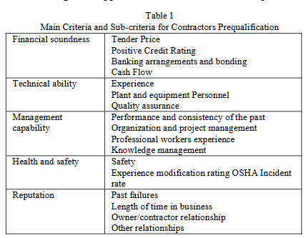
Components of Prequalification
Three Tier Prequalification
Administrative
Performance Based
Project Specific
Sanjana Patil et.al., Review of Contractor Prequalification Criteria and their Impact on Project Success Factors; International Journal of Research in Engineering, Science, and Management
Volume-3, Issue-7, July-2020

Slide 11
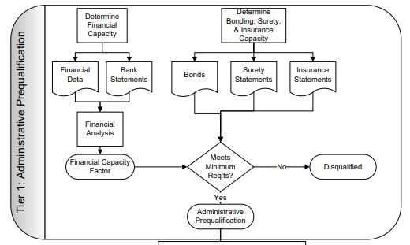
Tier 1 Administrative Prequalification
Administrative prequalification: A set of procedures and accompanying forms and documentation that must be submitted for inclusion on an agency’s approved bidders list. These forms may include an evaluation of financial statements, the dollar amount of work remaining under contract, available equipment and personnel, and previous work experience. This information may be provided on a project-by-project basis or on a specified periodic basis, such as annually
Gransberg, D.D. and Riemer, C. (2009) “Performance-Based Construction Contractor Prequalification,” NHRP Synthesis 390, Transportation Research Board, Washington, DC.

Slide 12
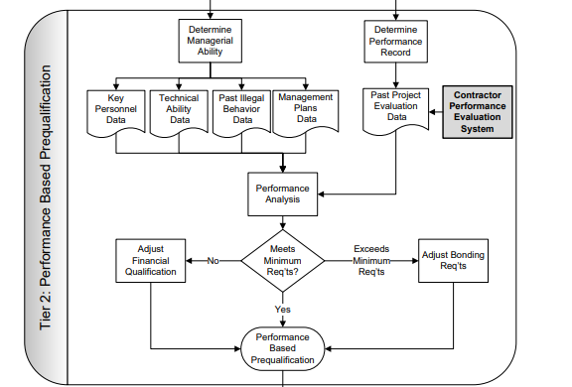
Tier 2 Performance-based prequalification
A set of procedures and backup documents that must be followed by a construction contractor to qualify to submit a bid on a construction project based on quality, past performance, safety, specialized technical capability, project-specific work experience, key personnel, and other factors. This information may be provided on a project by-project basis or on a specified periodic basis. The project could be delivered using traditional DBB or alternative project delivery methods such as DB, CM/GC, or any other method.
Gransberg, D.D. and Riemer, C. (2009) “Performance-Based Construction Contractor Prequalification,” NHRP Synthesis 390, Transportation Research Board, Washington, DC.

Slide 13
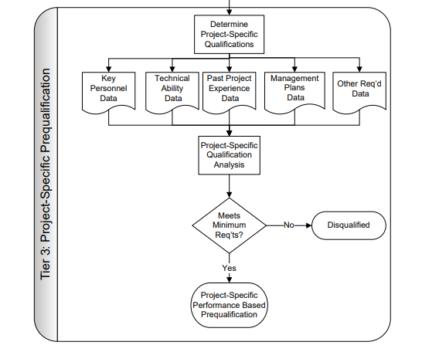
Tier 3 Project-specific prequalification
Contractor prequalification requirements that exist only for a single project. These requirements normally address project technical and procurement factors that are essential for the success of the given project. They may include criteria that require the contractor to have had past experience building a certain technology (i.e., seismic retrofit, intelligent transportation systems, etc.) or a given project delivery method such as DB. The requirements may extend to cover specific experience for key project personnel and specific types of plant and equipment.
Gransberg, D.D. and Riemer, C. (2009) “Performance-Based Construction Contractor Prequalification,” NHRP Synthesis 390, Transportation Research Board, Washington, DC.

Slide 14
Identifies Financially Unstable Contractors Before They Bid
Evaluates financial health through bonding capacity, cash flow, and financial statements
Avoids awarding contracts to firms likely to default
Reduces Defaults, Change Orders, and Project Delays
Reduces defaults by screening out contractors with poor performance or legal disputes
Minimizes change orders by evaluating contractor experience and competence
Avoids project delays by ensuring contractors have necessary resources
Case Example: Data on Rigorous Vetting and Default Rates
Ontario's Ministry of Transportation reduced defaults through multi-tiered evaluation
Supports Public Confidence and Accountability
Enhances Long-Term Risk Mitigation
Benefits:
Risk Reduction
Notes:
Contractor prequalification reduces risks by identifying financially unstable contractors, minimizing defaults, change orders, and project delays. It supports public confidence and accountability, and enhances long-term risk mitigation by building a pool of reliable contractors and encouraging better practices. Original Content: Key Benefits of Contractor Prequalification: Risk Reduction Contractor prequalification serves as a proactive risk management tool, enabling public agencies to mitigate financial, operational, and legal risks associated with school facilities projects. Below is an expanded exploration of how prequalification reduces risks: 1. Identifies Financially Unstable Contractors Before They Bid One of the primary purposes of contractor prequalification is to evaluate a contractor's financial health. This includes assessing key metrics such as: Bonding Capacity: Demonstrates a contractor's ability to secure performance and payment bonds, which are essential for large public works projects. Cash Flow and Credit: Ensures the contractor can manage day-to-day operational expenses without jeopardizing project timelines. Financial Statements: A review of audited financial statements highlights solvency, debt levels, and overall fiscal stability. By identifying contractors with weak financial standings, public agencies can avoid awarding contracts to firms that are more likely to default or face liquidity issues mid-project. This proactive step significantly reduces risks of project failure, costly delays, or litigation. 2. Reduces Defaults, Change Orders, and Project Delays a. Reducing Defaults Contractor defaults can disrupt a project, leading to increased costs and prolonged timelines. Prequalification screens out contractors with a history of financial instability, poor performance, or legal disputes, minimizing the risk of: Non-completion of projects due to insolvency or lack of resources. Contract terminations, which can result in costly re-bidding processes. Data from Performance-Based Contractor Prequalification Reports demonstrates that projects utilizing prequalified contractors experience default rates below 1%, a significant improvement over non-prequalified systems. This shows the effectiveness of prequalification in ensuring project stability​Performance based contr…. b. Reducing Change Orders Change orders are often caused by contractors who underestimate project complexity or lack the expertise to deliver as promised. Prequalification evaluates a contractor’s: Experience with similar projects: Ensures they have successfully completed projects of comparable scope, scale, and complexity. Competence in project planning: Demonstrates their ability to provide accurate estimates and timelines. By filtering out underqualified contractors, prequalification minimizes unexpected change orders, which can escalate costs and delay completion. c. Avoiding Project Delays Delays in school construction projects can have significant implications, such as: Disrupting student schedules and school operations. Increasing costs due to inflation in labor and materials. Prequalification ensures contractors have the resources, workforce, and management capacity to adhere to project schedules, avoiding costly delays and disruptions. 3. Case Example: Data on Rigorous Vetting and Default Rates Studies and real-world data from performance-based prequalification systems highlight the impact of rigorous contractor screening: Ontario's Ministry of Transportation: Implemented a prequalification system that drastically reduced contractor defaults through a multi-tiered evaluation system. Florida Department of Transportation (FDOT): Uses an “Ability Factor” in its prequalification process, which evaluates past performance and capacity, resulting in consistently low default rates​Performance based contr…. California School Facilities: Local districts that have adopted comprehensive prequalification practices report lower rates of legal disputes, change orders, and default-related re-bids, resulting in significant cost savings. 4. Supports Public Confidence and Accountability When public funds are involved, contractor prequalification fosters trust and accountability by ensuring that only the most capable contractors are allowed to compete. Stakeholder Confidence: Taxpayers and school boards are assured that projects will be completed on time and within budget, reducing backlash or political scrutiny. Contractor Accountability: Prequalification establishes clear expectations and benchmarks for performance, making contractors more likely to meet obligations. 5. Enhances Long-Term Risk Mitigation Contractor prequalification has long-term benefits beyond individual projects: Builds a Pool of Reliable Contractors: Over time, prequalification systems create a network of trusted contractors, reducing the likelihood of engaging high-risk firms in future projects. Encourages Better Contractor Practices: Contractors strive to meet prequalification criteria, fostering improvements in financial stability, safety records, and performance quality. Conclusion Risk reduction is one of the most significant benefits of contractor prequalification. By identifying financially unstable contractors, minimizing defaults, avoiding unnecessary change orders, and preventing project delays, prequalification ensures school facilities projects are delivered with greater reliability, efficiency, and cost-effectiveness. Moreover, rigorous vetting systems safeguard public funds, uphold project timelines, and enhance community confidence in public works.

Slide 15
Benefits: Quality Control
Ensures High Construction Standards by Selecting Proven Contractors
Past Project Experience: Demonstrates experience with similar projects
Reputation for Excellence: Reviews of references and previous outcomes
Safety and Compliance: Screening for safety regulations and labor laws
Technical Proficiency: Ability to meet technical specifications
Risk-Based Quality Control: Excludes contractors with substandard work history
Emphasizing Performance-Based Evaluation Systems
FDOT’s Ability Factor: Performance-based score from past projects
Benefits for School Facilities Projects
Creating a Culture of Accountability
Long-Term Benefits of Quality Control Through Prequalification
Notes:
Contractor prequalification ensures high construction standards by selecting proven contractors. Performance-based evaluation systems like FDOT’s Ability Factor and Ontario’s multi-tiered system enhance quality. Benefits include durable construction, regulatory compliance, and specialized expertise. Prequalification fosters accountability, reduces maintenance costs, and enhances stakeholder trust. Original Content: Key Benefits of Contractor Prequalification: Quality Control One of the cornerstone benefits of contractor prequalification is its ability to uphold and enhance construction quality by selecting contractors with a proven track record of successful project delivery. This ensures that public school facilities projects meet high construction standards, adhere to safety and regulatory requirements, and achieve long-term durability. 1. Ensures High Construction Standards by Selecting Proven Contractors Contractor prequalification evaluates a firm’s history and ability to consistently deliver high-quality work. Key aspects of quality assurance in prequalification include: a. Proven Track Record Past Project Experience: Contractors must demonstrate experience with projects of similar scope, size, and complexity. This ensures they possess the necessary skills, tools, and expertise to meet project demands. Reputation for Excellence: Prequalification includes reviews of references, client testimonials, and previous project outcomes, ensuring only contractors with strong performance histories are selected. b. Adherence to Quality Standards Safety and Compliance: Contractors are screened for compliance with safety regulations and labor laws, reducing the risk of on-site accidents that could compromise project quality. Technical Proficiency: Evaluations include the contractor’s ability to meet technical specifications, including specialized construction methods or materials required for school facilities. c. Risk-Based Quality Control Contractors with a history of substandard work, disputes, or claims are excluded, mitigating risks of rework or structural failures that could lead to costly repairs and maintenance. 2. Emphasizing Performance-Based Evaluation Systems Performance-based evaluation systems add an objective, data-driven layer to contractor prequalification. These systems focus on measuring past performance and translating it into predictive indicators of future success. Examples include: a. Florida Department of Transportation (FDOT) – “Ability Factor” FDOT has implemented a highly effective prequalification system that includes an Ability Factor, which is a performance-based score derived from contractors’ past projects. Key features: Contractor Performance Ratings: Scores are based on timely completion, adherence to budget, quality of work, and safety records. Tailored Evaluation: Higher-performing contractors are rewarded with higher "ability factors," making them more competitive in future bids. Proven Results: FDOT has reported improved construction quality and reduced project delays and claims by focusing on past performance. b. Ontario’s Ministry of Transportation – Multi-Tiered Prequalification Ontario uses a multi-tiered system to assess contractor eligibility for large public infrastructure projects: Tier 1 (Baseline Evaluation): Financial stability, safety compliance, and bonding capacity. Tier 2 (Performance Metrics): Past performance evaluations, adherence to timelines, and quality of work. Performance Incentives: Contractors with strong performance histories gain access to larger and more complex projects. Outcome: This system has reduced contractor-related issues and virtually eliminated the need for performance bonds on public works projects. 3. Benefits for School Facilities Projects For public school facilities, contractor prequalification based on quality control metrics ensures: Durable and Safe Construction: Facilities are built to last, reducing the likelihood of structural issues, safety hazards, or maintenance backlogs. Regulatory Compliance: Contractors meet stringent California building codes, seismic safety standards, and environmental requirements. Specialized Expertise: Many school construction projects require contractors with expertise in HVAC systems, energy-efficient designs, and ADA compliance, which prequalification systems prioritize. 4. Creating a Culture of Accountability By emphasizing quality control, contractor prequalification incentivizes contractors to maintain high standards to remain eligible for future projects: Continuous Improvement: Contractors are motivated to improve performance to maintain or enhance their prequalification status. Reduction in Low-Bid Challenges: A prequalification system ensures that even the lowest bidders meet minimum quality standards, mitigating risks of poor workmanship. 5. Case Study: Real-World Impact of Quality-Driven Prequalification Florida DOT Example Problem: Prior to implementing its “Ability Factor,” FDOT faced frequent issues with project delays and substandard workmanship from low-bid contractors. Solution: By adopting performance-based prequalification, FDOT improved contractor selection and reduced disputes over project quality. Outcome: The “Ability Factor” has resulted in higher-quality construction, lower defect rates, and increased satisfaction among stakeholders. Ontario’s Multi-Tiered System Problem: Ontario’s transportation projects required contractors capable of managing complex, large-scale infrastructure projects. Solution: The multi-tiered system rewarded high-performing contractors with access to larger contracts, ensuring only the most qualified firms handled critical infrastructure. Outcome: Project quality improved significantly, with reduced delays and disputes, creating a reliable network of contractors. 6. Long-Term Benefits of Quality Control Through Prequalification a. Reduced Maintenance and Repair Costs Selecting contractors with proven records of quality work reduces the likelihood of structural issues, ensuring facilities remain functional and safe for extended periods. b. Enhanced Stakeholder Trust By ensuring quality outcomes, prequalification fosters trust among taxpayers, school boards, and communities. c. Long-Term Sustainability Quality control ensures that public school facilities are built to meet modern educational and environmental standards, aligning with long-term sustainability goals. Conclusion By ensuring only contractors with a proven track record of quality performance are eligible to bid, prequalification reduces the risks of substandard construction and ensures public school projects are built to the highest standards. Performance-based evaluation systems like Florida DOT’s “Ability Factor” and Ontario’s multi-tiered prequalification highlight the importance of data-driven assessments in achieving superior construction quality, safety, and long-term cost savings.

Slide 16
Benefits: Streamlined Project Execution
Prequalified Contractors Demonstrate Competence
Specialized expertise for complex projects
Established track record of successful project execution
Effective resource and workforce management
Reduces Administrative Burden and Oversight Costs
Simplifies the contractor selection process
Minimizes need for constant oversight
Enhances coordination among stakeholders
Cost Savings for School Facilities Personnel
Accelerates Project Timelines
Fosters Confidence Among Stakeholders
Notes:
Contractor prequalification ensures efficient project execution by selecting competent contractors. It reduces administrative burdens, oversight costs, and accelerates timelines. This process fosters stakeholder confidence and provides cost savings. Real-world examples include FDOT and Ontario's Ministry of Transportation. Original Content: Key Benefits of Contractor Prequalification: Streamlined Project Execution Contractor prequalification plays a pivotal role in improving the efficiency of public school facilities projects by ensuring that only competent, experienced, and reliable contractors are permitted to bid. This leads to streamlined project execution, reducing delays, administrative burdens, and oversight costs, while enabling smooth project delivery even under complex or high-pressure conditions. 1. Prequalified Contractors Demonstrate Competence in Managing Large-Scale, Complex Projects a. Specialized Expertise for Complex Projects Prequalification ensures that contractors have prior experience in handling projects of similar scope, size, and complexity. This is especially critical for school facilities projects, which often involve: Seismic retrofitting to meet California safety standards. Specialized systems like HVAC, energy-efficient designs, and ADA-compliant facilities. Coordinating construction schedules around academic calendars to minimize disruption. Contractors with demonstrated experience are more likely to anticipate challenges, implement best practices, and manage resources effectively, ensuring timely and high-quality project delivery. b. Established Track Record Prequalified contractors must show a history of successful project execution, including: Meeting deadlines under tight schedules. Staying within budget constraints. Collaborating effectively with multiple stakeholders (school boards, architects, inspectors, etc.). Their proven ability to deliver results minimizes risks of delays or conflicts that can disrupt project timelines. c. Resource and Workforce Management Prequalification ensures contractors have the necessary workforce capacity, equipment, and supply chain management to handle large-scale projects efficiently. By selecting contractors with a solid resource base, school facilities personnel can avoid project disruptions caused by labor shortages or supply chain issues. 2. Reduces Administrative Burden and Oversight Costs a. Simplifies the Contractor Selection Process Prequalification narrows the pool of eligible bidders to contractors who meet predefined criteria, eliminating the need for extensive post-bid evaluations. School facilities personnel can focus on evaluating competitive bids from pre-screened, capable contractors rather than scrutinizing unqualified or inexperienced ones. b. Minimizes Need for Constant Oversight Prequalified contractors are familiar with public project requirements, regulatory compliance, and reporting standards. This reduces the need for excessive oversight and monitoring during construction. Contractors with a history of adherence to safety, labor laws, and quality standards require less intervention from project managers, freeing up time and resources for other priorities. c. Enhances Coordination Among Stakeholders Contractors who have demonstrated their ability to collaborate effectively with architects, engineers, and inspectors reduce the administrative burden of resolving miscommunication or disputes. School districts and facilities personnel benefit from streamlined communication, which accelerates decision-making and keeps the project on track. 3. Cost Savings for School Facilities Personnel a. Reduced Legal and Financial Risks By prequalifying contractors with strong financial stability and excellent performance records, school districts reduce the likelihood of legal disputes, project delays, and costly change orders. This minimizes the administrative time and legal expenses required to address such issues. b. Lower Management and Inspection Costs With reliable contractors in place, school facilities personnel can reduce time spent on continuous inspections or audits to ensure work is performed correctly. Prequalified contractors are more likely to adhere to specifications and timelines, requiring less on-site supervision. c. Improved Budget Allocation Administrative savings from reduced oversight and efficient project execution allow districts to allocate more funds toward other critical needs, such as curriculum development, technology upgrades, or maintenance. 4. Accelerates Project Timelines a. Quick Start-Up Prequalification eliminates delays caused by the need to verify contractor qualifications after bids are submitted. By conducting this vetting process in advance, projects can begin without unnecessary administrative hold-ups. b. Mitigates Delays During Construction Prequalified contractors are less likely to encounter unexpected issues such as mismanagement of resources or noncompliance with safety standards. This results in fewer work stoppages and delays, ensuring that school facilities are delivered on time. 5. Fosters Confidence Among Stakeholders a. Trust in Contractor Capabilities School boards, taxpayers, and community members gain confidence knowing that contractors have been vetted for competence and reliability. This trust is especially important when managing high-profile or time-sensitive projects. b. Demonstrates Accountability A streamlined process backed by a robust prequalification system shows stakeholders that public funds are being managed responsibly and that project outcomes will meet expectations. 6. Real-World Example: Streamlined Execution Through Prequalification Case Study: Florida Department of Transportation (FDOT) FDOT uses performance-based prequalification to streamline contractor selection for large infrastructure projects. This approach has significantly reduced administrative overhead while improving project outcomes: Contractors are prequalified based on financial stability, performance history, and technical capabilities. The streamlined process has led to faster project start times and fewer delays during construction, saving the agency millions in administrative and oversight costs. Ontario’s Multi-Tiered Prequalification System Ontario’s Ministry of Transportation reduced project delays and management costs by implementing a multi-tiered prequalification system. Prequalified contractors delivered high-quality work with minimal need for intensive oversight, allowing project managers to focus on strategic priorities instead of day-to-day supervision. Conclusion Contractor prequalification significantly enhances project execution efficiency by ensuring that only capable and reliable contractors are selected. This leads to: Competent Management of Complex Projects: Contractors with the right expertise and resources deliver high-quality results on time and within budget. Reduced Oversight Costs: Prequalification minimizes the need for intensive supervision, saving time and money for school facilities personnel. Faster Project Timelines: By streamlining the contractor selection process, prequalification accelerates project start times and reduces delays. For school facilities personnel, these benefits are especially valuable during economic downturns or periods of high demand, ensuring that public school projects are delivered efficiently, effectively, and with long-term durability.

Slide 17
Florida Department of Transportation (FDOT)
Key Features of the 'Ability Factor'
Performance Ratings: Evaluates contractors based on past project performance
Reward System: High ratings lead to better scores and competitiveness
Tailored Evaluation: Considers contractor's ability to handle project complexity
Results and Impact
Improved Contractor Performance: Incentivizes high standards
Reduced Project Risks: Minimizes defaults and disputes
Cost Savings: Reduces rework and delays, saving taxpayer dollars
Relevance to School Facilities
Ensures school construction projects are completed efficiently and to high standards
Notes:
The FDOT's 'Ability Factor' system evaluates contractors based on past performance, rewarding high ratings. This approach has improved contractor performance, reduced project risks, and saved costs. It ensures school construction projects are completed efficiently and to high standards. Original Content: 1. Florida Department of Transportation (FDOT): "Ability Factor" The Florida Department of Transportation (FDOT) has implemented a performance-based prequalification system that includes an "Ability Factor" to evaluate contractors based on past performance and capabilities. Key Features of the "Ability Factor" Performance Ratings: Contractors are rated based on their performance on previous projects, including adherence to budgets, timelines, and quality standards. Reward System: Contractors with high performance ratings receive better "Ability Factor" scores, making them more competitive for future bids. Tailored Evaluation: Ratings consider the contractor's ability to handle the complexity and scope of projects, ensuring only those with relevant experience are selected. Results and Impact Improved Contractor Performance: By incentivizing contractors to maintain high standards, FDOT has seen significant improvements in quality and timeliness across projects. Reduced Project Risks: Systematic evaluations have minimized defaults and disputes, leading to smoother project execution. Cost Savings: Better contractor selection has reduced rework and delays, saving millions in taxpayer dollars. Relevance to School Facilities The FDOT system demonstrates how performance-based metrics can drive contractor accountability, ensuring school construction projects are completed efficiently and to high standards.

Slide 18
Ontario Ministry of Transportation
Key Features of the Multi-Tiered System
Tier 1: Baseline Evaluation
Tier 2: Performance-Based Metrics
Eliminating Performance Bonds
Highly prequalified contractors are not required to provide performance bonds
Track record demonstrates reliability and risk mitigation
Results and Impact
Reduced Costs: Significant savings by eliminating performance bonds
Enhanced Quality Control: Ensures only capable contractors handle critical projects
Fewer Disputes and Claims: Minimizes issues during project execution
Notes:
The Ontario Ministry of Transportation developed a multi-tiered prequalification system to select capable contractors. This system reduces costs, enhances quality control, and minimizes disputes. It can be applied to school facilities to lower costs and maintain high standards. Original Content: 2. Ontario Ministry of Transportation: Multi-Tiered Prequalification System The Ontario Ministry of Transportation (MTO) developed a multi-tiered prequalification system to ensure only capable contractors are selected for public infrastructure projects, eliminating the need for performance bonds in many cases. Key Features of the Multi-Tiered System Tier 1: Baseline Evaluation Assesses contractors' financial stability, bonding capacity, and compliance with labor and safety regulations. Tier 2: Performance-Based Metrics Evaluates contractors' track record, including timely project completion, quality of work, and claims history. Contractors with superior performance gain access to higher-value and more complex projects. Eliminating Performance Bonds Highly prequalified contractors are not required to provide performance bonds, as their track record demonstrates reliability and risk mitigation. Results and Impact Reduced Costs: Eliminating performance bonds has saved the Ministry significant funds while maintaining contractor accountability. Enhanced Quality Control: The tiered system ensures only the most capable contractors are entrusted with large-scale, critical projects. Fewer Disputes and Claims: Rigorous prequalification has minimized issues during project execution, ensuring smoother delivery. Relevance to School Facilities Ontario’s success highlights the potential for public agencies to reduce costs and improve outcomes by adopting performance-based prequalification systems. For school districts, similar practices could help lower administrative costs while maintaining high construction standards.

Slide 20
Performance-based Prequalification Model Algorithms
“Old Faithful”
Bidding Capacity = The least of Past Performance, Financial Review, or Bonding Capacity, if they have a passing application score and passing reference interviews
Past performance is calculated by averaging the two largest public works, then multiplying by 0.33 if under $10 million or 0.5 if over $10 million
The financial review calculates the working capital and net worth and multiplies it by a multiplier (usually between 5 and 10)
Single project bonding capacity

Slide 21
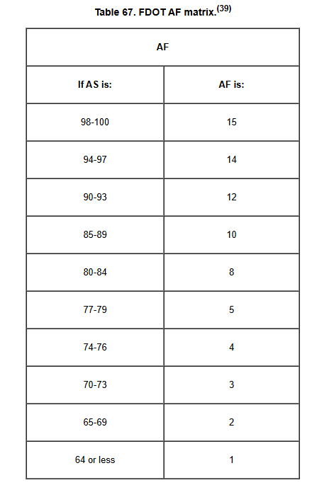
Performance-based Prequalification Model Algorithms
FDOT Ability Factor
MCR = AF x CRF x ANW
Where:
MCR = Max Capacity Rating
AF = Ability Factor
CRF = Current Ratio Factor (adj net assets/adj net liabilities)
ANW = Adjusted Net Worth (total liabilities – total assets)
IOWADOT Financial Focus
Bidding Capacity = Current Assets - Current Liabilities - ½ (Net Current Assets - Net Current Liabilities)(Ability Factor)

Slide 22
Prequalification Model Algorithms of the Future
Machine Learning Integration
Blockchain-Based Verification
Dynamic Risk Assessment Models
Neural networks analyzing historical performance data
Real-time project monitoring integration
Early-stage implementation by major construction firms
Smart contracts for automated performance tracking
Immutable performance history
Being tested by several European construction consortiums
Real-time financial health monitoring
Integration with project management software
Currently in beta testing by major insurance providers

Slide 23
THANK YOU!
SURVEY
CODE
INSIGHT

